Slide 1

CORA: MORINGA SCHOOL’S FAQ CHATBOT

Slide 2



Robert Ng’ang’a
Urbanus Kathitu
Faith Muigai
Virginia Kamande
Anthony Njoya

Slide 3

Introduction: Purpose
To collect and analyze data on user behavior and preferences
To automate customer support and improve user experience
To provide a conversational interface for users to interact with on the Moringa school website at ease

Slide 4


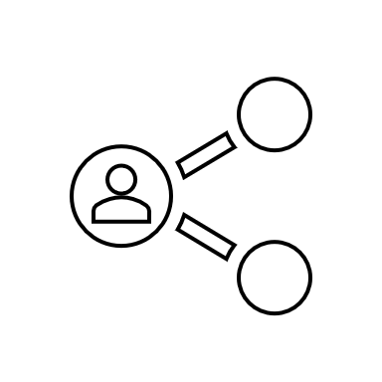
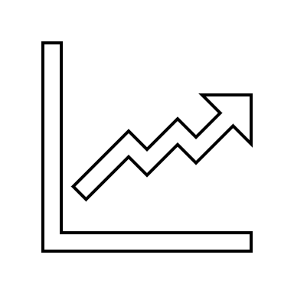
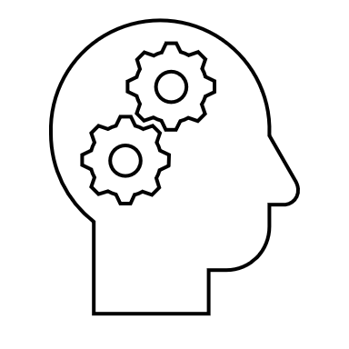
Objectives
To design and develop a chatbot that meets the needs of the target audience
To increase user engagement and satisfaction with Moringa School.
To reduce customer support workload and improve efficiency
To gather insights on user behavior and preferences to inform future product development

Slide 5

Overview of Chatbots

Slide 6





Definition
Computer program
Simulates human conversation
Through voice commands, text chats, or both.

Slide 7

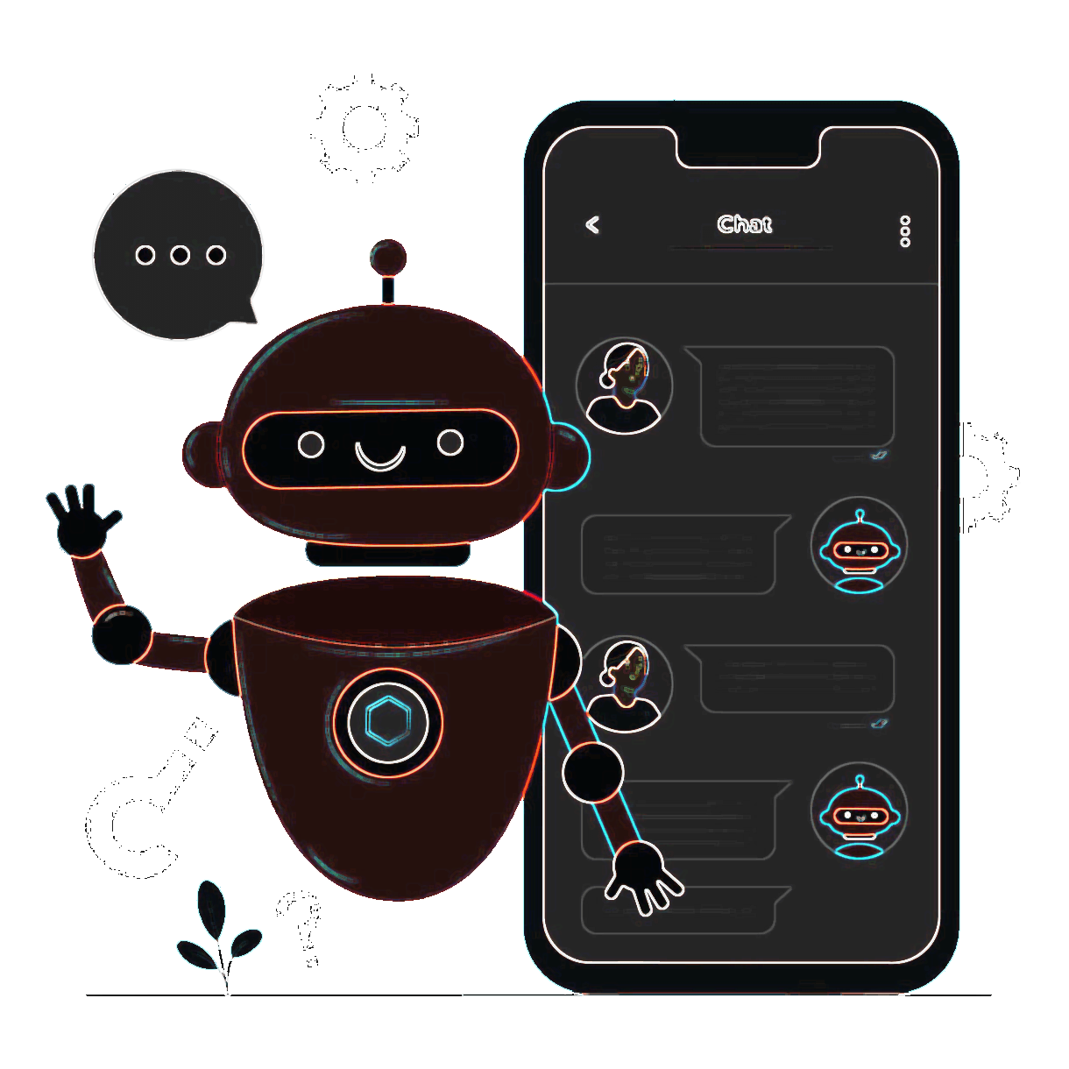

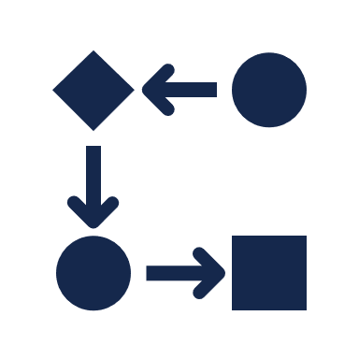
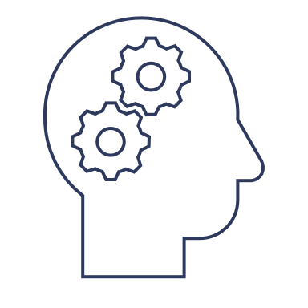


How It Works
Natural Language Processing (NLP)
Machine Learning Algorithms
To understand user queries and provide appropriate responses.

Slide 8




Benefits of Using Chatbots for Customer Support
24/7 AVAILABILITY
FASTER RESPONSE TIMES
CONSISTENT AND ACCURATE RESPONSES
COST-EFFECTIVE

Slide 9



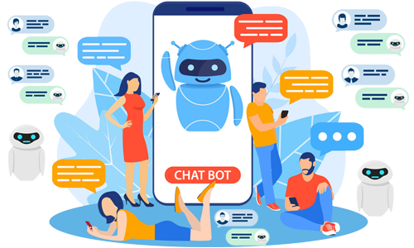
Examples of companies using chatbots for customer support

Slide 10
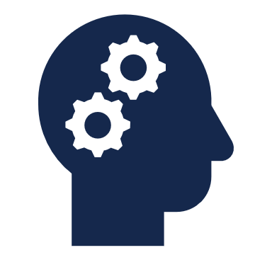
NPL Techniques
Natural Language Processing (NLP) is a branch of AI that enables computers to understand and process human language.

Slide 11


NPL Techniques Used
Intent recognition
Entity recognition
Identifies the user's intent from their message.
Extracts relevant information from the user's message.

Slide 12
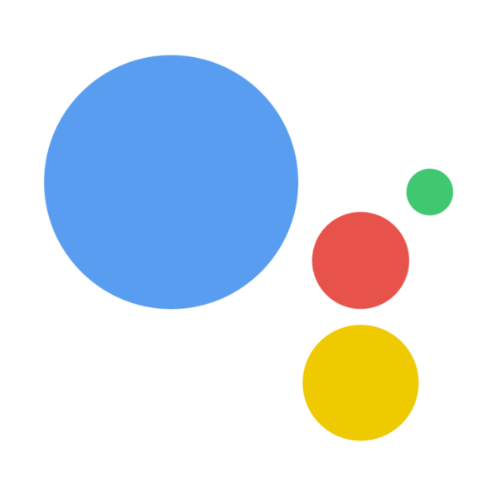


Examples of chatbots using NLP
Google Assistant
Alexa
Siri

Slide 13

Machine Learning Algorithms

Slide 14

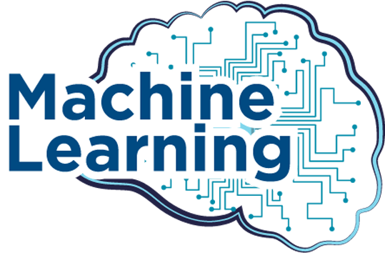
Can be used to improve the performance of our FAQ chatbot by analyzing user interactions and feedback to identify areas for improvement. The chatbot can then be trained on this data to provide more accurate and helpful responses.
They are already widely used in other applications such as image recognition, speech recognition, and recommendation systems. Netflix, for example, uses machine learning algorithms to recommend personalized content to users based on their viewing history.
Algorithms

Slide 15




Project Overview
Goal:
Scope:
Timeline:
Outcome:
To provide a reliable and efficient customer support experience by automating the handling of frequently asked questions.
Designing and developing the chatbot, integrating it with the Moringa School website, and testing its performance to ensure accuracy and effectiveness.
Includes several stages, including data collection, model development, testing and refining, and deployment.
The success of the project will be measured by several factors, including customer satisfaction and feedback, the number of successfully resolved inquiries, and the reduction in customer support workload.

Slide 16

Data Collection and Preprocessing
Collect and preprocess enough high-quality data from the Moringa School website, that represents customer inquiries and possible responses. This is crucial for our chatbot accuracy and performance, and therefore its success.

Slide 17


Intent Recognition
The process of identifying the intention behind a user's message.
It's a crucial part of our chatbot development because it enables us to understand what the user wants and provide the right response. For example, if a customer/client asks a question about “Financial aid”, the chatbot should recognize that the intent is to inquire about “Financial aid”and provide an appropriate answer.

Slide 18
Chatbot Development
The process involves using various tools and technologies to implement natural language processing techniques and machine learning algorithms (Python programming language, TensorFlow, and tflearn)
Machine learning algorithms (e.g. Naive Bayes and Support Vector Machines) will be used to improve the chatbot performance over time.
The chatbot will utilize intent recognition and entity recognition, techniques to understand and respond to customer queries.

Slide 19




Testing and Evaluation
We used both manual and automated testing methods to ensure the chatbot's accuracy and efficiency.
Some of the test cases we used included asking the chatbot questions related to the FAQ, testing its ability to recognize different intents, and evaluating its responses to various user inputs.
We measured the chatbot's accuracy and efficiency by its performance when interacting with a user.
We will conduct user testing to get feedback on the chatbot's performance and make any necessary improvements.

Slide 20


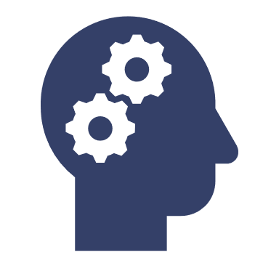

Results and Conclusion
Our FAQ chatbot has demonstrated high accuracy and efficiency in responding to user queries.
Based on user satisfaction metrics, it has successfully met our goals of improving customer support and reducing response times.
The chatbot's potential applications are widespread, including customer support for various industries and educational purposes.
As future directions for the project, we plan to integrate more advanced NLP techniques and machine learning algorithms to further improve the chatbot's performance.
The success of this project highlights the power of AI and machine learning in revolutionizing customer support and enhancing user experiences.

